Slide 1
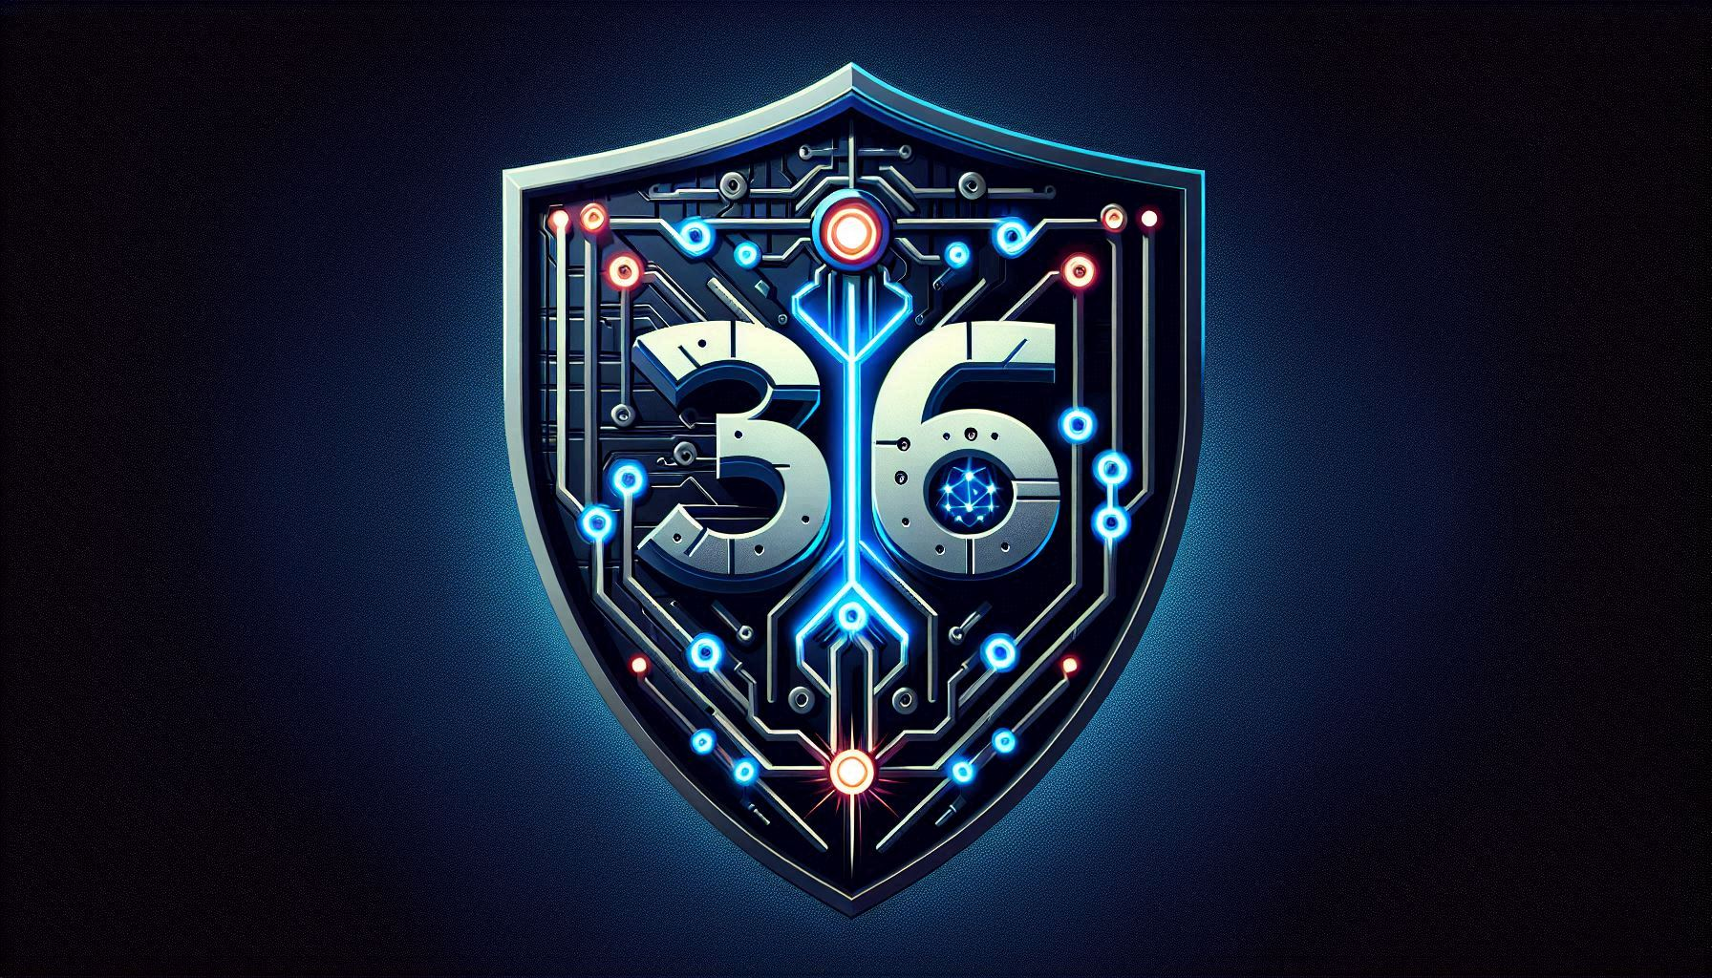
The Viability of the U.S. Cyber Defense against foreign adversaries and Adaptive Cybersecurity through Public-Private Partnership
By Wilbert Bean III

Slide 2
Recap
Capstone Focus: The ever-evolving landscape of the U.S. Cyber Defense
Primary Points:
U.S. Cyber Defense through Offensive Strategies
Nation State-Sponsored Adversary Campaigns and Defensive Strategies
Adaptive Cybersecurity and Public-Private Partnerships
Notes:
My capstone paper represents the culmination of my senior seminar research, delving into the complex and ever-evolving landscape of United States cyber defense.
This work examines pivotal moments in cyber warfare, from the groundbreaking development of Stuxnet to the disruptive attacks on critical infrastructure, highlighting the critical role of public-private partnerships in shaping a resilient cyber future.
It explores the United States' cyber defense capabilities through a multi-faceted analysis of historical and contemporary cyber warfare actions and strategic responses.
In the next slide I will discuss the framework encapsulating Critical Infrastructure Security and Resilience, Legislation, Acts, and Presidential Actions, and Federal Plans, Strategies, and Guidance.

Slide 3
The Framework
Critical Infrastructure Security and Resilience, Legislation, Acts, and Presidential Actions, and Federal Plans, Strategies, and Guidance constitute the Framework for the U.S. Cyber Defense Apparatus in protecting critical infrastructure.
Notes:
The framework was designed by me to reduce the large scope of what these topics cover. In the next slide we will review the U.S. Cyber Defense Apparatus for Protecting Critical Infrastructure derived from my capstone.

Slide 4
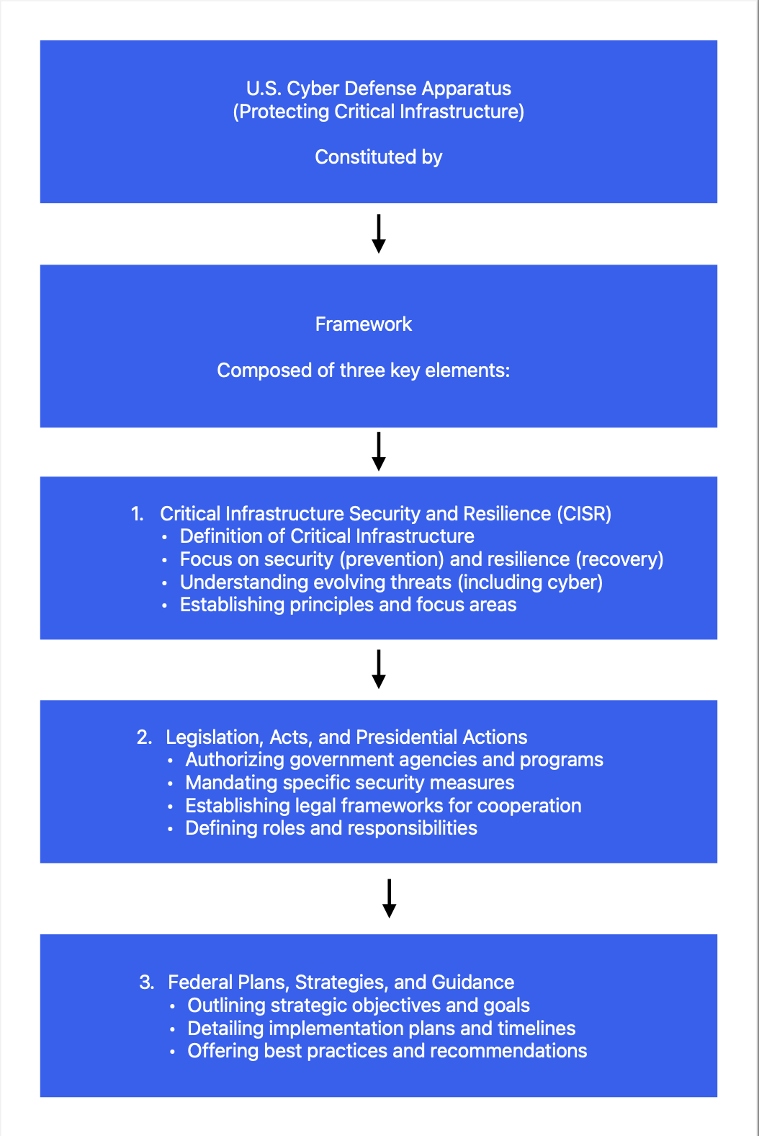
Notes:
CISR (Critical Infrastructure Security and Resilience): Defines the scope of what needs to be protected (critical infrastructure), emphasizes both security (preventing attacks) and resilience (recovering from them), and provides a modern understanding that includes cyber threats alongside physical ones. It also establishes focus areas like risk-informed decision-making and public-private cooperation.
Legislation, Acts, and Presidential Actions: Provide the legal authority, mandates, and structures necessary to implement and maintain CISR. They formalize the roles and responsibilities of government agencies and, importantly, establish the framework for public-private partnerships. These legal instruments demonstrate the government's commitment and provide the basis for funding and action.
Federal Plans, Strategies, and Guidance: Outline the specific strategies, objectives, and operational frameworks for achieving CISR. Documents like the National Infrastructure Protection Plan (NIPP) provide guidance on risk management, information sharing, and partnership structures. These plans translate the high-level goals set by legislation into actionable steps.
In essence, these three components work together to:
Define the problem: Identifying critical infrastructure and the evolving threats (CISR).
Establish the rules and responsibilities: Creating the legal framework for action (Legislation).
Provide the roadmap for action: Outlining the strategies and operational plans (Federal Plans).
This information establishes the foundation which will be built upon discussing the more recent threats facing the U.S. We will begin with identifying the US Cyber Defense agencies.

Slide 5
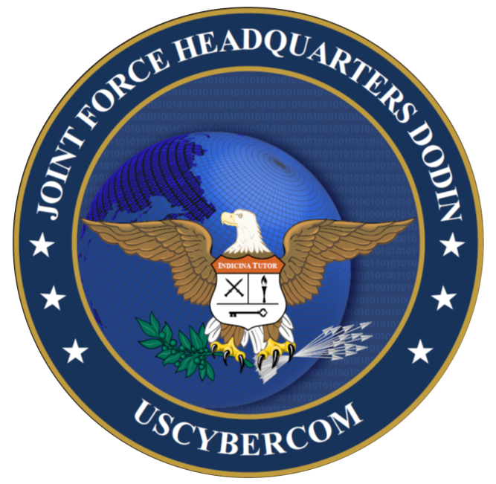
U.S. Cyber Defense Agencies
CISA
NSA
FBI
USCYBERCOM
Notes:
These four agencies form a critical interconnected infrastructure within the U.S. Cyber Defense Apparatus. I will expand upon each agency in the subsequent slides providing details such as identification, roles, responsibilities, functions, and collaborations.

Slide 6
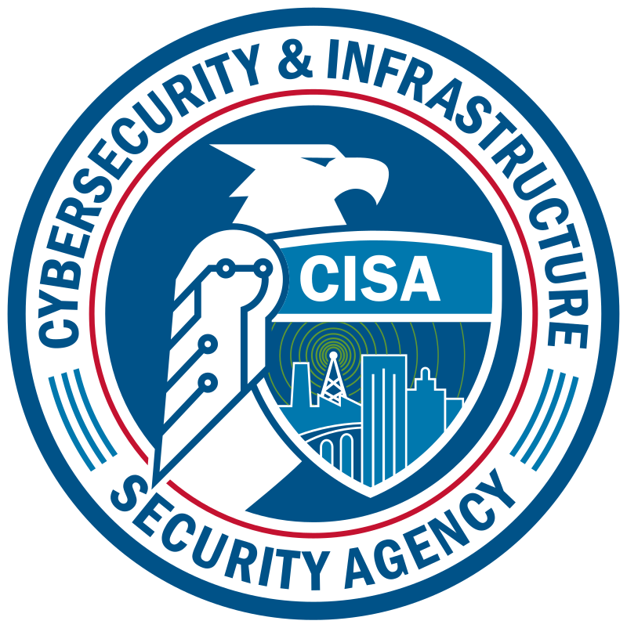
CISA
Identification
As the National Coordinator for Critical Infrastructure Security and Resilience, CISA works with partners at every level to identify and manage risk to the cyber and physical infrastructure that Americans rely on every hour of every day(1).
Role and Responsibilities
CISA is the lead federal agency for cybersecurity and infrastructure security(1).
Notes:
National Coordinator: CISA coordinates national efforts to understand, manage, and reduce risks to cyber and physical infrastructure.
Operational Lead for Federal Cybersecurity: CISA is responsible for protecting federal civilian networks.
Critical Infrastructure Security and Resilience: CISA works with sector-specific agencies to enhance the security and resilience of critical infrastructure.
Information Sharing and Analysis: CISA serves as a central hub for sharing cyber threat information and best practices.
Technical Assistance and Capacity Building: CISA provides tools, resources, and training to improve cybersecurity capabilities across the nation.
Real-world example: In response to the SolarWinds supply chain attack, CISA played a central coordinating role, working with the FBI and NSA to understand the scope of the breach, disseminate information, and provide guidance to affected organizations. CISA also collaborated with USCYBERCOM on understanding the nation-state actor involved and potential further threats.

Slide 7
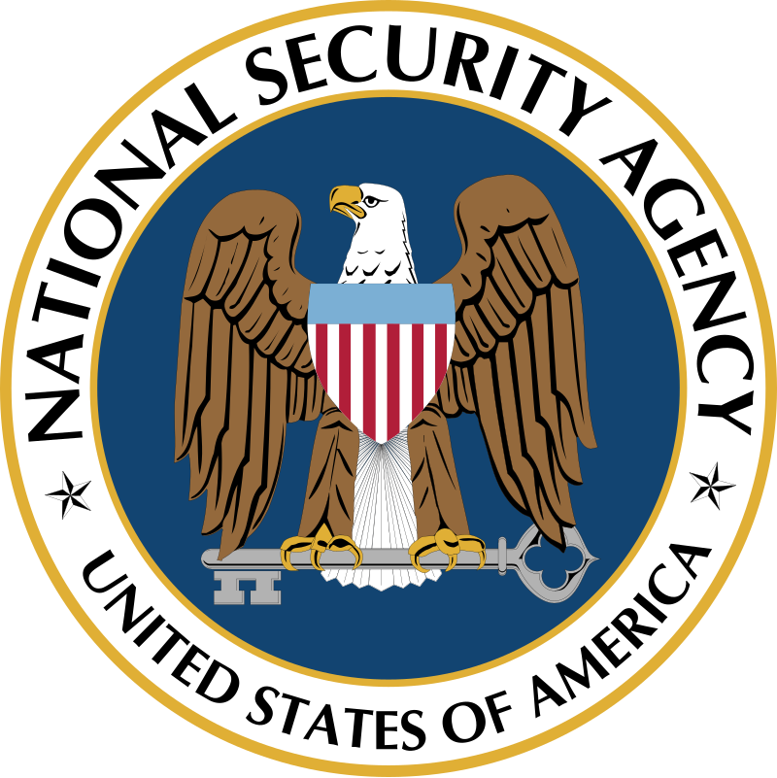
NSA
Identification
The National Security Agency/Central Security Service (NSA/CSS) leads the U.S. Government in cryptology that encompasses both signals intelligence (SIGINT) insights and cybersecurity products and services and enables computer network operations to gains decisive advantage for the nation and our allies(2).
Role and Responsibilities
The NSA is primarily focused on foreign intelligence gathering and protecting U.S. national security systems (2).
Notes:
Signals Intelligence: The NSA collects and analyzes foreign communications to provide intelligence for national security decision-makers.
Cybersecurity for National Security Systems: The NSA is responsible for securing U.S. national security systems, including those of the Department of Defense and intelligence agencies.
Cryptographic Expertise: The NSA is the U.S. government's leading authority on cryptography.
Advanced Cyber Capabilities: The NSA develops advanced tools and techniques for both offensive and defensive cyber operations.
Real-world example: The NSA's expertise in analyzing sophisticated malware was crucial in understanding the Stuxnet worm, which targeted Iran's nuclear facilities. This information was likely shared with other agencies to improve understanding of nation-state cyber capabilities and develop defenses.

Slide 8
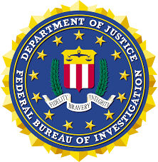
FBI
Identification
The Federal Bureau of Investigation prioritizes helping protect citizens, children, communities, and businesses from dangerous threats facing the nation - from international and domestic terrorists to spies on U.S. soil, from cyber villains to corrupt government officials, from mobsters to violent street gangs, from child predators to serial killers(3).
Role and Responsibilities
The FBI is the primary federal law enforcement agency responsible for investigating cybercrime within the United States (3).
Notes:
The FBI investigates a wide range of cybercrimes, including hacking, data breaches, ransomware attacks, and online fraud.
National Cyber Investigative Joint Task Force (NCIJTF): The FBI leads this task force, which brings together law enforcement, intelligence, and military agencies to coordinate cyber investigations.
Victim Support: The FBI works with victims of cybercrime to provide assistance and gather information.
Deterrence: The FBI aims to deter cybercrime through investigations, arrests, and prosecutions.
Intelligence Gathering: The FBI gathers intelligence on cyber threats to inform law enforcement and national security efforts.
Real-world example: When the Colonial Pipeline ransomware attack occurred, the FBI played a crucial role in the investigation, identifying the perpetrators and eventually recovering some of the ransom payment. They also worked with CISA to understand the impact on critical infrastructure and coordinate the response.

Slide 9
USCYBERCOM
Identification
The United States Cyber Command (USCYBERCOM), the nation’s unified combatant command for the cyberspace domain (4). The Command has three main focus areas: Defending DODIN, providing support to combatant for execution of their missions around the world, and strengthening our nation’s ability to withstand and respond to cyber attack (4).
Role and Responsibilities
USCYBERCOM is a sub-unified command of the U.S. Department of Defense responsible for military cyberspace operations (4).
Notes:
Defense of DoD Information Networks (DoDIN): USCYBERCOM is responsible for securing the DoD's networks and systems.
Support to Combatant Commanders: USCYBERCOM conducts cyber operations to support the missions of other military commands.
Offensive Cyber Operations: USCYBERCOM conducts offensive cyber operations to deter adversaries, disrupt their activities, and support national security objectives.
Developing Cyber Capabilities: USCYBERCOM develops and maintains the cyber weapons and tools used by the U.S. military.
Real-world example: USCYBERCOM's "Hunt Forward" operations involve deploying teams to partner nations to help them defend their networks and gain insights into adversary tactics.This proactive approach allows USCYBERCOM to understand threats that could eventually target U.S. infrastructure and share that information with agencies like CISA and the FBI.
In conclusion, while each agency has a distinct mission, their close collaboration, information sharing, and coordinated operations are essential for a robust and effective national cyber defense. This multi-layered approach leverages the unique strengths of each agency to protect the United States from a wide range of cyber threats. So what are these agencies defending against, be a question you are wondering at this point. In the next section we will review the most important threats.

Slide 10
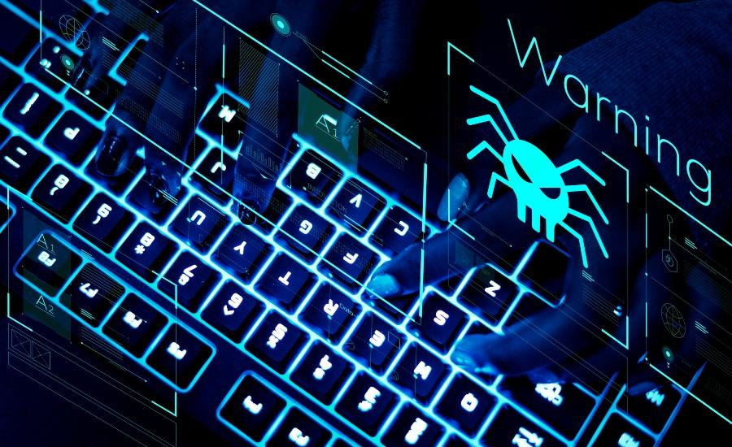
The Most Important Threats
Nation-State Attacks
Ransomware
Supply Chain Intrusions
Notes:
These three threats were selected because they were presented to me by my professor multiple times throughout my capstone project. I will expand upon these topics in the subsequent slides providing details on identification, industry definitions, and defense agency actions. Let’s get started with Nation-State Attacks.

Slide 11
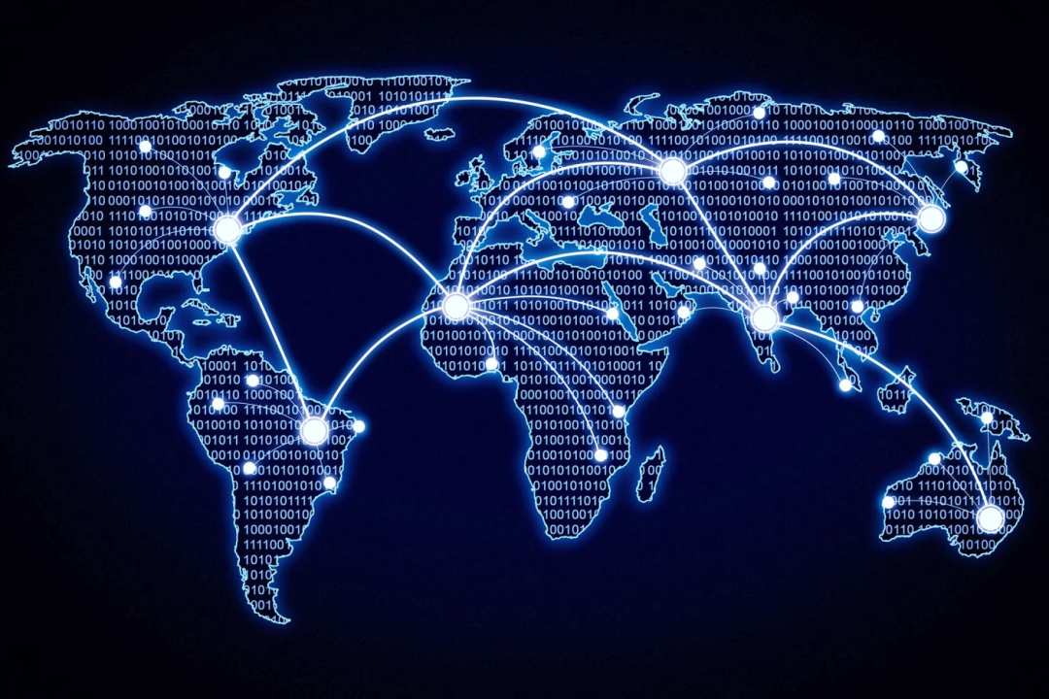
Nation-State Attacks
Identification
Nation-state adversaries pose an elevated threat to our national security. These adversaries are known for their advanced persistent threat (APT) activity:
The Chinese government—officially known as the People’s Republic of China (PRC)
The Russian government—officially known as the Russian Federation
The North Korean government—officially known as the Democratic People’s Republic of Korea (DPRK)
The Iranian government—officially known as the Islamic Republic of Iran
(Nation-State Cyber Actors | Cybersecurity and Infrastructure Security Agency CISA, n.d.)
Notes:
CISA: As the nation's cyber defense agency, CISA coordinates national efforts to understand, manage, and reduce risks from nation-state attacks.
They provide guidance, resources, and tools to enhance online security, urging organizations to adopt a heightened security posture.
CISA also collaborates with other agencies and international partners to issue advisories and proactively improve cyber resilience.

Slide 12
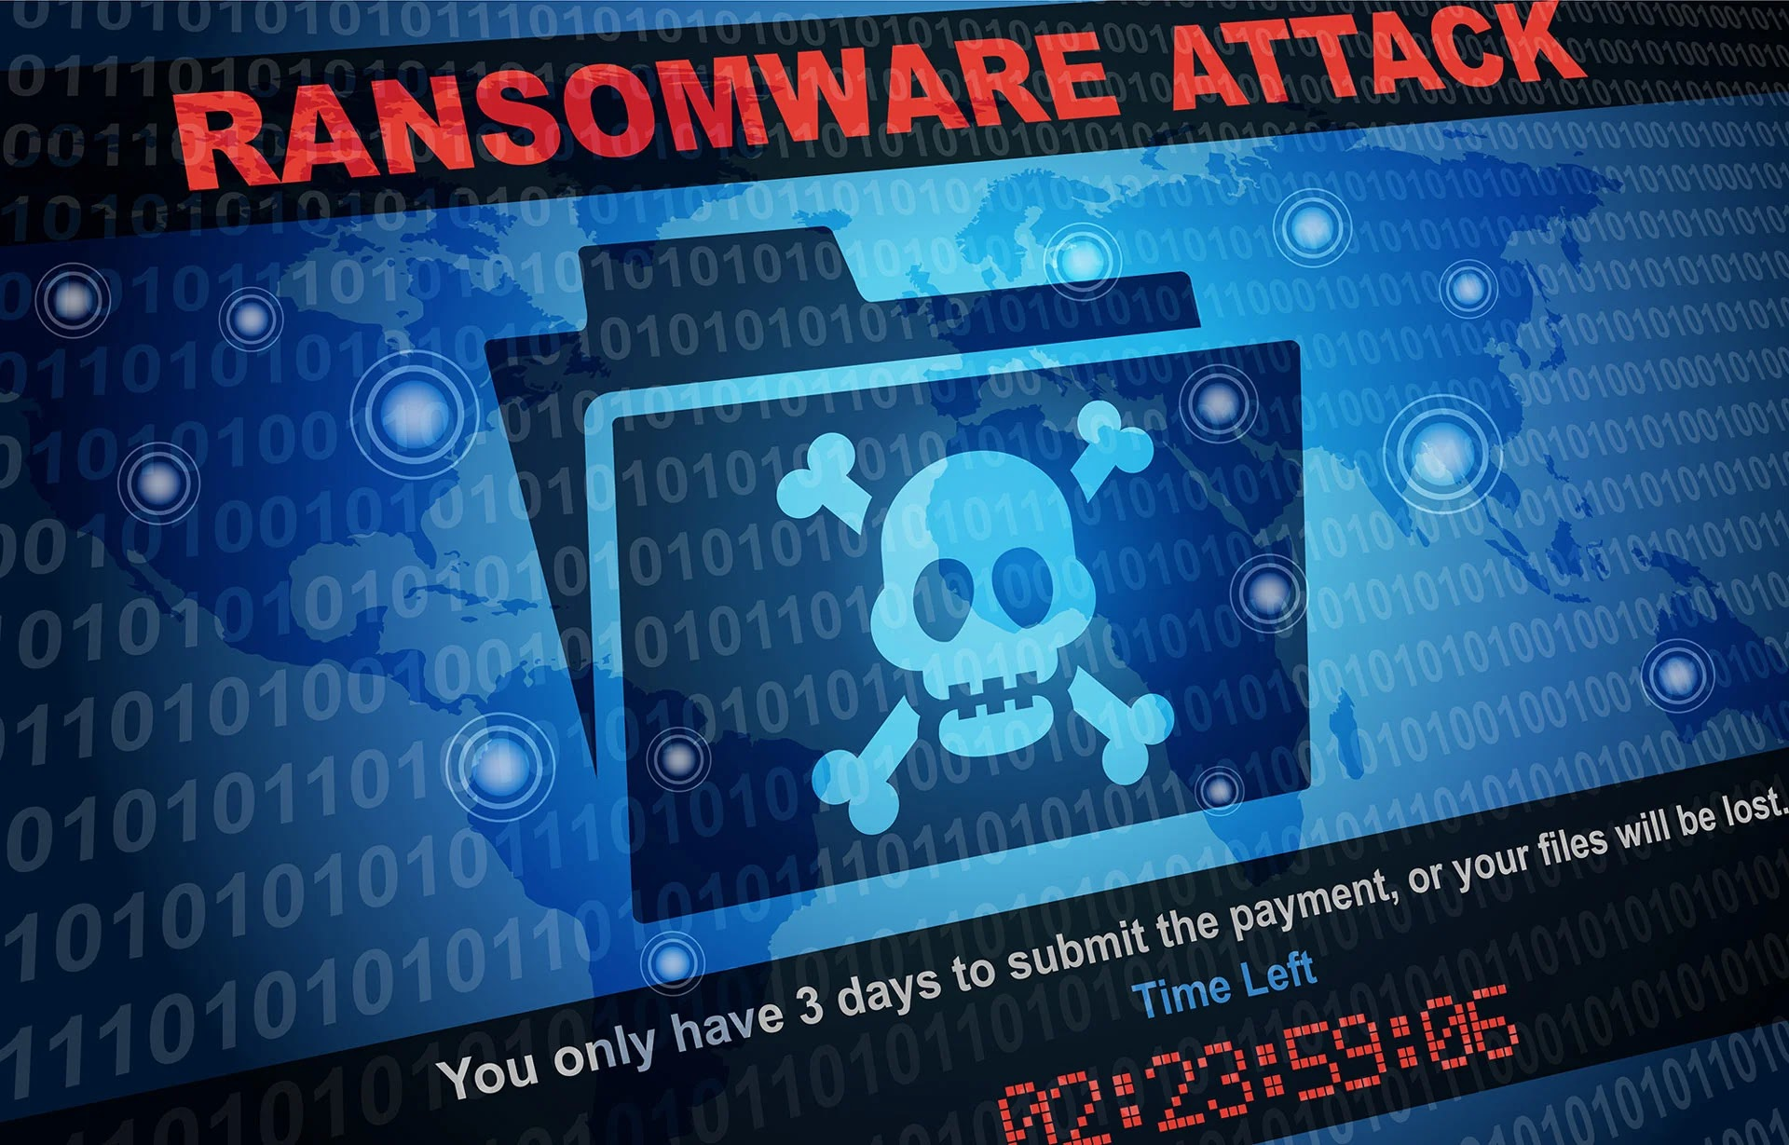
Ransomware
Identification
According to the FBI, Ransomware is a type of malicious software—or malware—that prevents you from accessing your computer files, systems, or networks and demands you pay a ransom for their return.
Ransomware attacks can cause costly disruptions to operations and the loss of critical information and data(6).
Notes:
The FBI investigates ransomware attacks and works to prevent and disrupt cyberattacks.
NSA: The NSA works with CISA and the FBI to release advisories and guidance on ransomware trends.
Joint Efforts: CISA, FBI, NSA, and the Multi-State Information Sharing and Analysis Center (MS-ISAC) have published the #StopRansomware Guide, which provides best practices to reduce the risk of ransomware incidents.

Slide 13
Supply Chain Intrusions
Identification
According to Cloudflare a prominent multi-tiered web security provider, a supply chain attack uses third-party tools or services - collectively referred to as a supply chain - to infiltrate a target’s system or network (8).
Notes:
The NSA is actively addressing supply chain security vulnerabilities, issuing guidance and recommendations to mitigate risks, including the use of Software Bill of Materials (SBOM) and promoting a Zero Trust security model (7).
Joint Efforts: CISA, NSA, and FBI work together to publish guides and advisories for protecting communications infrastructure and mitigating supply chain threats.
In conclusion the previous slides represent the most important threat the national security of the United States. We discussed what they were, provided some industry definitions from experts as well as discussed what the defense agencies are doing to protect the critical assets of the US. Next we will expand on defensive strategies to enhance the subject matter.

Slide 14
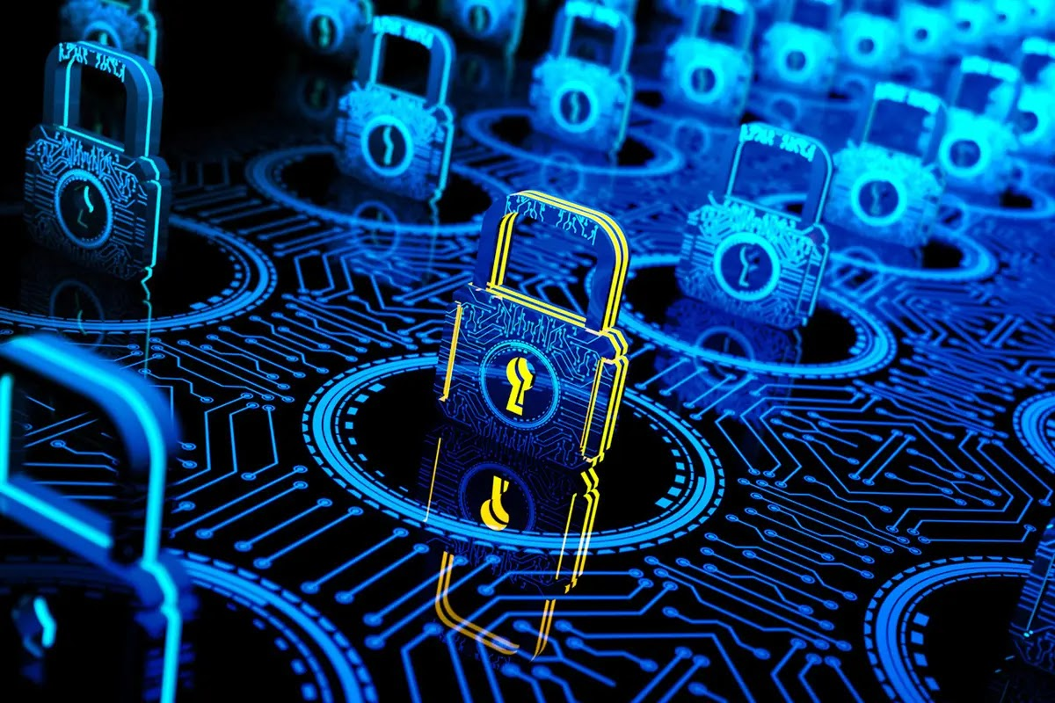
Defensive Strategies
Zero Trust
Public Private Partnerships
AI-Based threat detection
Offensive Cyber Operations
Notes:
These four strategies are not mutually exclusive and are often employed in a coordinated and layered approach to defend against the evolving cyber threat landscape. The defense agencies work together, each contributing their unique expertise and capabilities, to ensure a comprehensive national cyber defense.

Slide 15
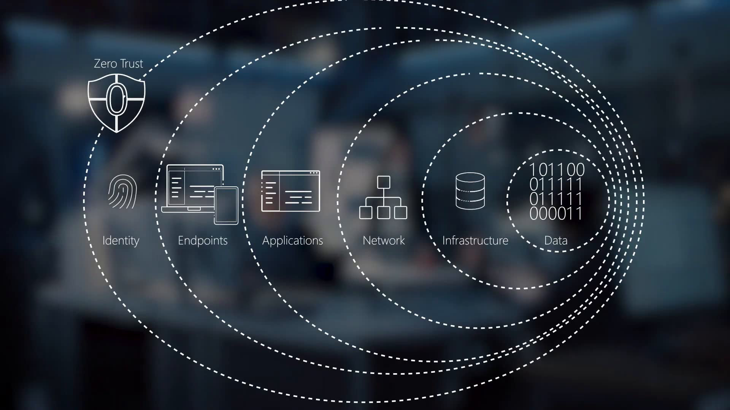
Zero Trust
Identification
According to CrowdStrike a cybersecurity endpoint security provider, the Zero Trust Framework is a security approach that assumes no user, device, or application is inherently trustworthy, requiring strict verification and authorization for every access request, regardless of location (12).
Notes:
Key Principles:
Assume Breach: The network is always considered to be breached.
Explicit Verification: Every user, device, and application must be authenticated and authorized.
Least Privilege Access: Users and applications are granted only the minimum access needed to perform their tasks.
Microsegmentation: Dividing the network into smaller, isolated zones to limit the "blast radius" of a potential breach.
Continuous Monitoring: Ongoing monitoring and validation of security posture.
Defense Agency Roles & Responsibilities:
CISA: Plays a significant role in promoting the adoption of Zero Trust architectures across federal agencies and critical infrastructure. CISA provides guidance, frameworks, and resources to help organizations implement Zero Trust principles. They also lead the Federal Zero Trust Strategy.
NSA: Provides technical expertise and guidance on implementing Zero Trust for National Security Systems (NSS) and the Defense Industrial Base (DIB). They offer insights into secure configurations and best practices for identity management, network segmentation, and data protection within a Zero Trust framework.
FBI: While not directly responsible for implementing Zero Trust, the FBI benefits from its adoption by other agencies and organizations. A Zero Trust environment can limit the lateral movement of attackers, potentially hindering cybercriminal and nation-state activities that the FBI investigates.
USCYBERCOM: Implements Zero Trust principles within the Department of Defense Information Network (DoDIN) to enhance its security posture. They develop and enforce policies that align with Zero Trust to protect military networks and data.

Slide 16
Public-Private Partnerships
Identification
A Public-Private Partnership (PPP) is a long-term collaboration between a government and a private sector entity to deliver a service or facility for the public, often involving private financing and risk-sharing (12).
Within the context of this subject matter the Public-Private Partnerships (PPPs) in cybersecurity involve collaboration between government agencies and private sector organizations to enhance the nation's overall cybersecurity posture. These partnerships leverage the unique expertise, resources, and information held by both sectors to address shared threats.
(11).”
Notes:
Key Aspects:
Information Sharing: Sharing threat intelligence, vulnerabilities, and best practices.
Joint Exercises and Planning: Conducting collaborative exercises to test incident response plans and improve coordination.
Technical Assistance: Government agencies providing expertise and resources to private sector entities, especially critical infrastructure operators.
Policy Development: Collaborating on the development of cybersecurity policies and standards.
Research and Development: Jointly pursuing research and development in cybersecurity technologies and strategies.
Defense Agency Roles & Responsibilities:
CISA: Is the primary federal agency for fostering and coordinating public-private partnerships in cybersecurity. CISA operates numerous programs and initiatives to facilitate information sharing through Information Sharing and Analysis Centers (ISACs) and other mechanisms. They work closely with critical infrastructure sectors to build resilience.
NSA: Collaborates with industry through its Cybersecurity Collaboration Center to share threat intelligence and develop security solutions. They also engage in partnerships to improve the security of the Defense Industrial Base.
FBI: Works with private sector companies, especially those that are victims of cybercrime, to investigate incidents, gather evidence, and share threat information. They participate in joint task forces with industry to combat cyber threats.
USCYBERCOM: Engages with private sector partners, particularly in the defense industrial base, to share threat information and improve the security of critical supply chains.

Slide 17
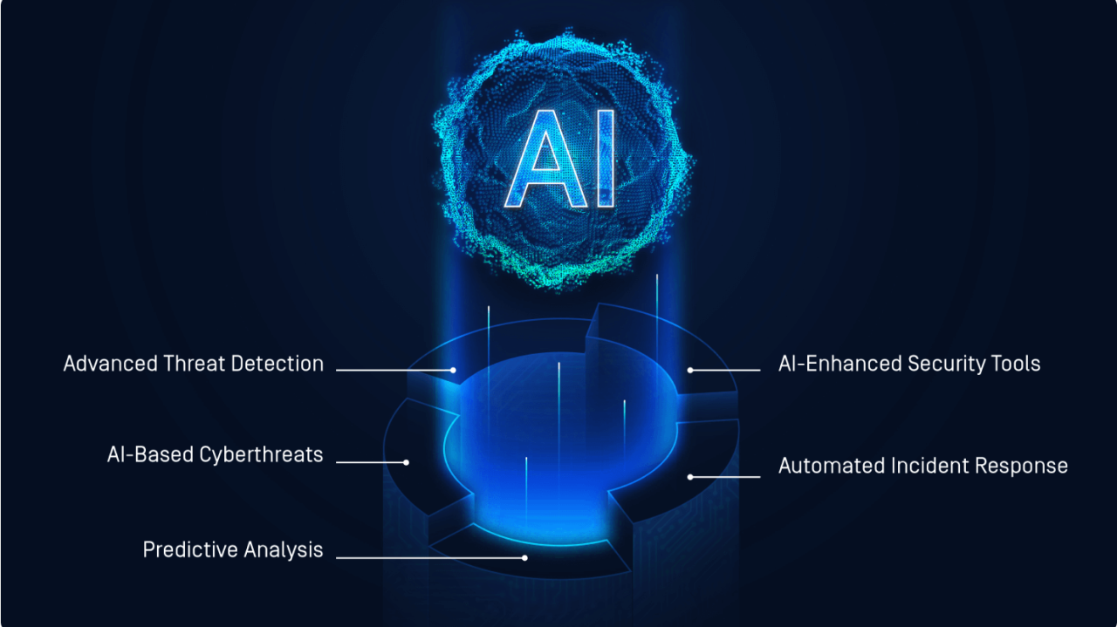
AI-Based Threat Detection
Identification
According to SentinelOne a US based cybersecurity firm specializing in AI-powered technology, AI threat detection is using machine learning and behavioral analytics to identify patterns and anomalies that indicate potential cyber threats, enabling faster and more accurate responses (10).
Notes:
AI-based threat detection utilizes artificial intelligence and machine learning algorithms to analyze large volumes of data (network traffic, logs, user behavior, etc.) to identify anomalies and patterns that may indicate cyber threats. This approach can detect both known and novel threats, including zero-day exploits, with greater speed and accuracy than traditional rule-based systems.
Key Capabilities:
Anomaly Detection: Identifying deviations from normal behavior that could indicate malicious activity.
Behavioral Analysis: Profiling user and system behavior to detect suspicious changes.
Machine Learning: Training algorithms on historical data to recognize patterns associated with attacks.
Natural Language Processing (NLP): Analyzing text-based data like emails and security reports to identify threats.
Predictive Analysis: Using AI to forecast potential future attacks based on current trends and vulnerabilities.
Defense Agency Roles & Responsibilities:
CISA: Promotes the use of AI-driven security tools and shares information about AI-related threats and vulnerabilities. They also work with industry to understand and mitigate risks associated with the use of AI in cyberattacks.
NSA: Leverages AI and machine learning for analyzing vast amounts of signals intelligence data to identify and understand sophisticated cyber threats. They also develop AI-powered tools for defending national security systems.
FBI: Uses AI to analyze digital evidence and identify patterns in cybercriminal activity, aiding in investigations and attribution.
USCYBERCOM: Employs AI for enhancing situational awareness on military networks, detecting sophisticated attacks, and potentially for automating certain defensive responses.

Slide 18
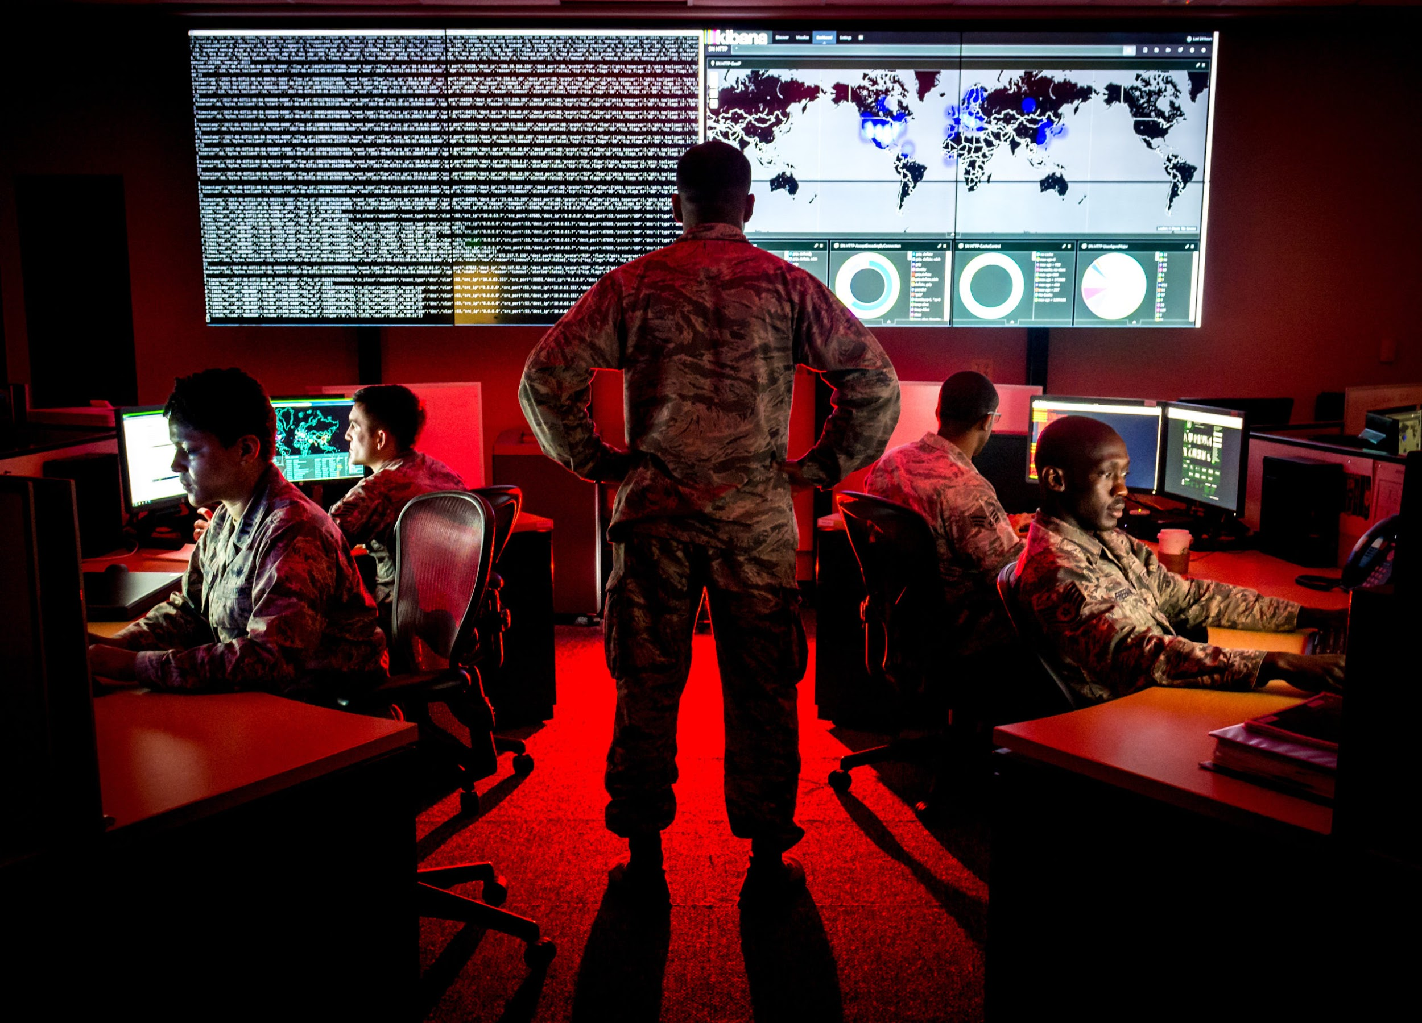
Offensive Cyber Operations
Identification
According to the National Institute of Standards and Technology, cyberspace operations intended to project power by force by the application of force in or through cyberspace (9).
Notes:
Offensive Cyber Operations (OCO) involve using cyber capabilities to manipulate, deny, disrupt, degrade, or destroy adversary computer systems, networks, or information. These operations are typically conducted by military and intelligence agencies to achieve national security objectives.
Key Characteristics:
Proactive Defense: OCO can be used to disrupt imminent attacks or degrade an adversary's cyber capabilities before they can be used.
Deterrence: The capability to conduct OCO can deter adversaries from launching cyberattacks against the U.S.
Intelligence Gathering: OCO can be used to gain access to adversary networks for intelligence collection.
Support to Military Operations: OCO can support conventional military operations by disrupting enemy communications or targeting their infrastructure.
Defense Agency Roles & Responsibilities:
USCYBERCOM: Is the primary agency responsible for conducting offensive cyber operations on behalf of the U.S. military. These operations are conducted under strict legal and policy frameworks and are aimed at supporting national security objectives.
NSA: Provides critical intelligence, technical expertise, and tools to support USCYBERCOM's offensive operations. The close relationship between the NSA and USCYBERCOM is crucial for the planning and execution of these operations.
FBI: While not directly conducting offensive operations in the same way as USCYBERCOM, the FBI may conduct certain types of "active defense" measures or "hunt forward" operations within legal frameworks to disrupt criminal cyber activity. They also gather intelligence that can inform potential offensive operations.
CISA: Does not have a direct role in conducting offensive cyber operations. Their focus is on defensive measures and protecting civilian infrastructure. However, information gathered by CISA about adversary tactics and techniques can inform the broader understanding of threats that might be targeted by offensive operations.
In the next slide i’ve provided a model to demonstrate the defensive strategy as a cohesive function.

Slide 19
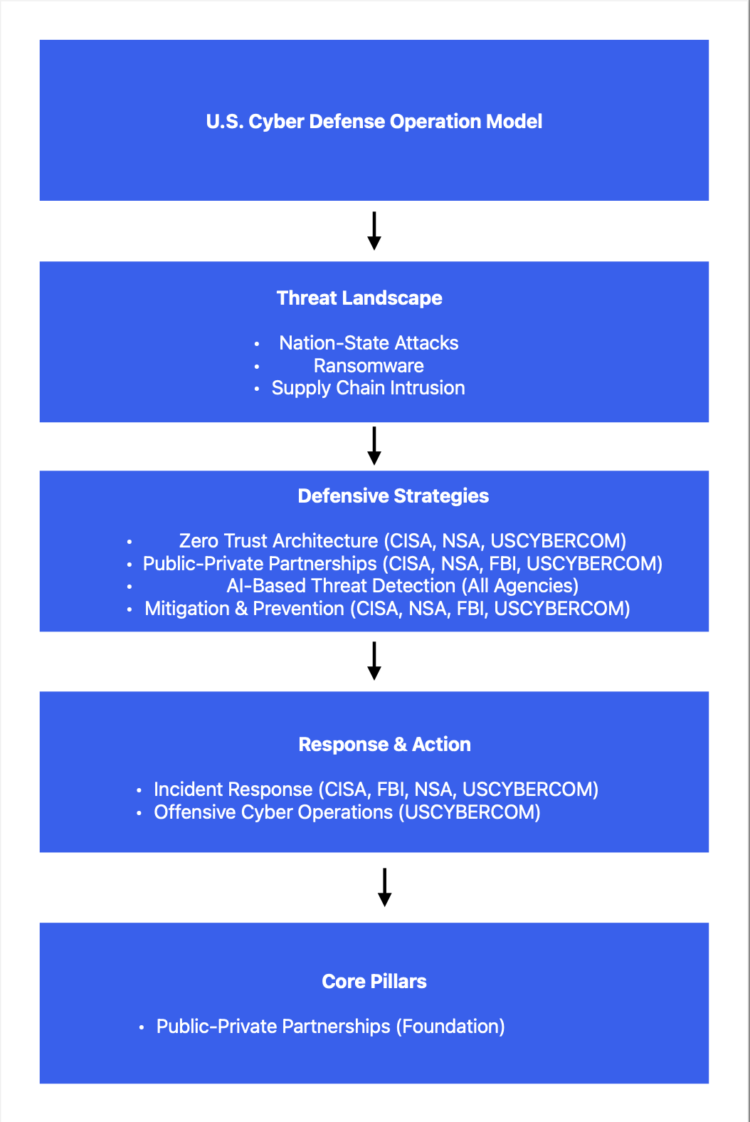
Notes:
Key Takeaways from the Model:
Collaboration is Paramount: Effective U.S. cyber defense relies heavily on the coordinated efforts of CISA, NSA, FBI, and USCYBERCOM, along with strong partnerships with the private sector.
Layered Approach: A combination of proactive defensive strategies and reactive response mechanisms is necessary to address the complex threat landscape.
CISA's Central Role: CISA plays a crucial coordinating role, especially in the civilian and critical infrastructure domains.
NSA's Technical Expertise: The NSA provides unique technical expertise and intelligence capabilities.
FBI's Law Enforcement Focus: The FBI is central to investigating and prosecuting cybercrime.
USCYBERCOM's Military Focus: USCYBERCOM is responsible for defending military networks and conducting offensive operations.
Let’s summarize this presentation and prepare to close out.

Slide 20
Summary
The U.S. Cyber Defense Framework:
Agencies
Threats
Defense Strategies
Notes:
These four strategies are not mutually exclusive and are often employed in a coordinated and layered approach to defend against the evolving cyber threat landscape. The defense agencies work together, each contributing their unique expertise and capabilities, to ensure a comprehensive national cyber defense.

Slide 21
Thank You!
References
About CISA | CISA. (n.d.). Cybersecurity and Infrastructure Security Agency CISA. https://www.cisa.gov/about
National Security Agency/Central Security Service. (n.d.). National Security Agency | About NSA Mission. https://www.nsa.gov/about/
Welcome to fbi.gov. (2025, March 27). Federal Bureau of Investigation. https://www.fbi.gov/
U.S. Cyber Command. (n.d.). Home USCYBERCOM. https://www.cybercom.mil/
Nation-State Cyber Actors | Cybersecurity and Infrastructure Security Agency CISA. (n.d.). https://www.cisa.gov/topics/cyber-threats-and-advisories/nation-state-cyber-actors
Ransomware. (2024, August 19). Federal Bureau of Investigation. https://www.fbi.gov/how-we-can-help-you/scams-and-safety/common-frauds-and-scams/ransomware
National Security Agency/Central Security Service. (n.d.). NSA releases recommendations to mitigate software supply chain risks. https://www.nsa.gov/Press-Room/Press-Releases-Statements/Press-Release-View/Article/3617462/nsa-releases-recommendations-to-mitigate-software-supply-chain-risks/
National Security Agency/Central Security Service. (n.d.). NSA releases recommendations to mitigate software supply chain risks. https://www.nsa.gov/Press-Room/Press-Releases-Statements/Press-Release-View/Article/3617462/nsa-releases-recommendations-to-mitigate-software-supply-chain-risks/
CSRC Content Editor. (n.d.). offensive cyberspace operations (OCO) - Glossary | CSRC. https://csrc.nist.gov/glossary/term/offensive_cyberspace_operations
SentinelOne. (2025, March 5). Why choose SentinelOne: Next-Gen Autonomous Cybersecurity. https://www.sentinelone.com/why-sentinelone/
National Security Agency/Central Security Service. (n.d.). National Security Agency | Central Security Service. https://www.nsa.gov/
What is Zero Trust? - Guide to Zero Trust Security | CrowdStrike. (n.d.). https://www.crowdstrike.com/en-us/cybersecurity-101/zero-trust-security/

